Slide 1
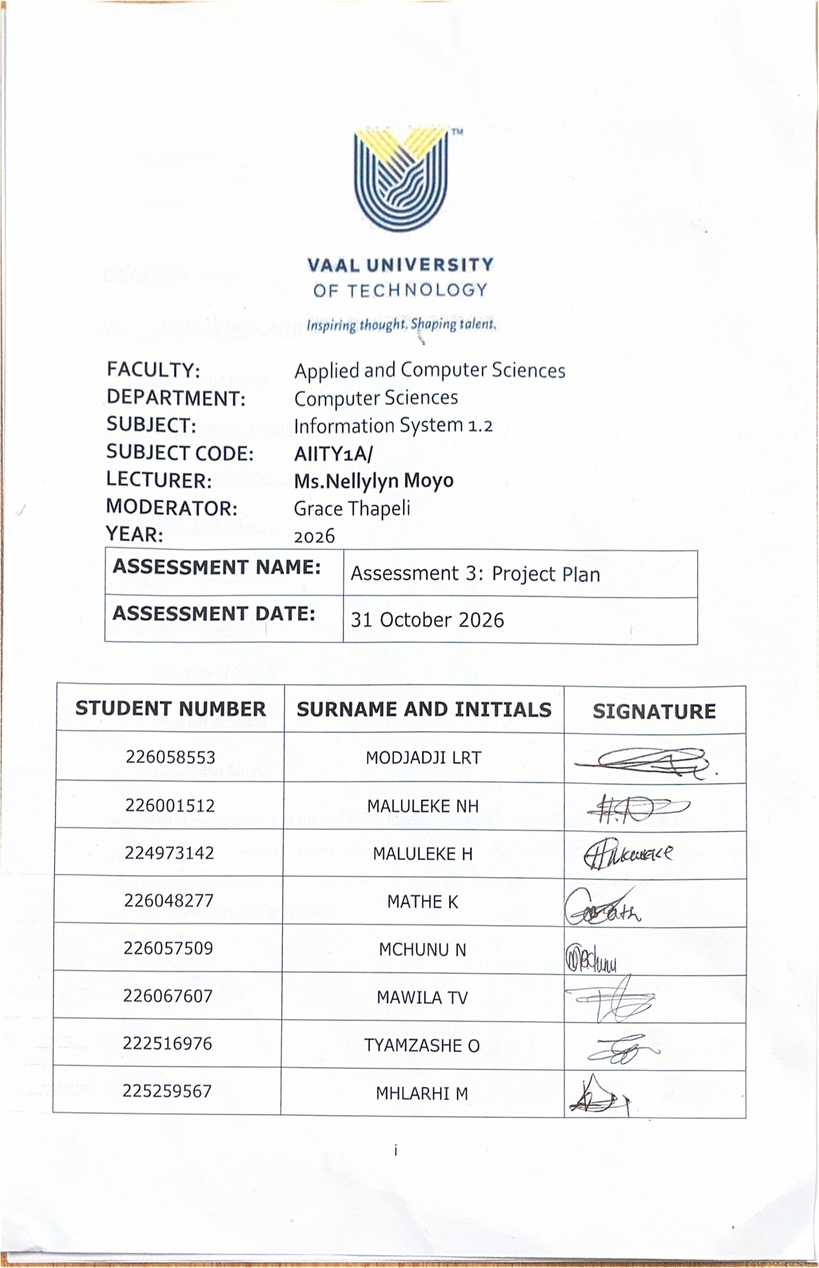
Declaration

Slide 2
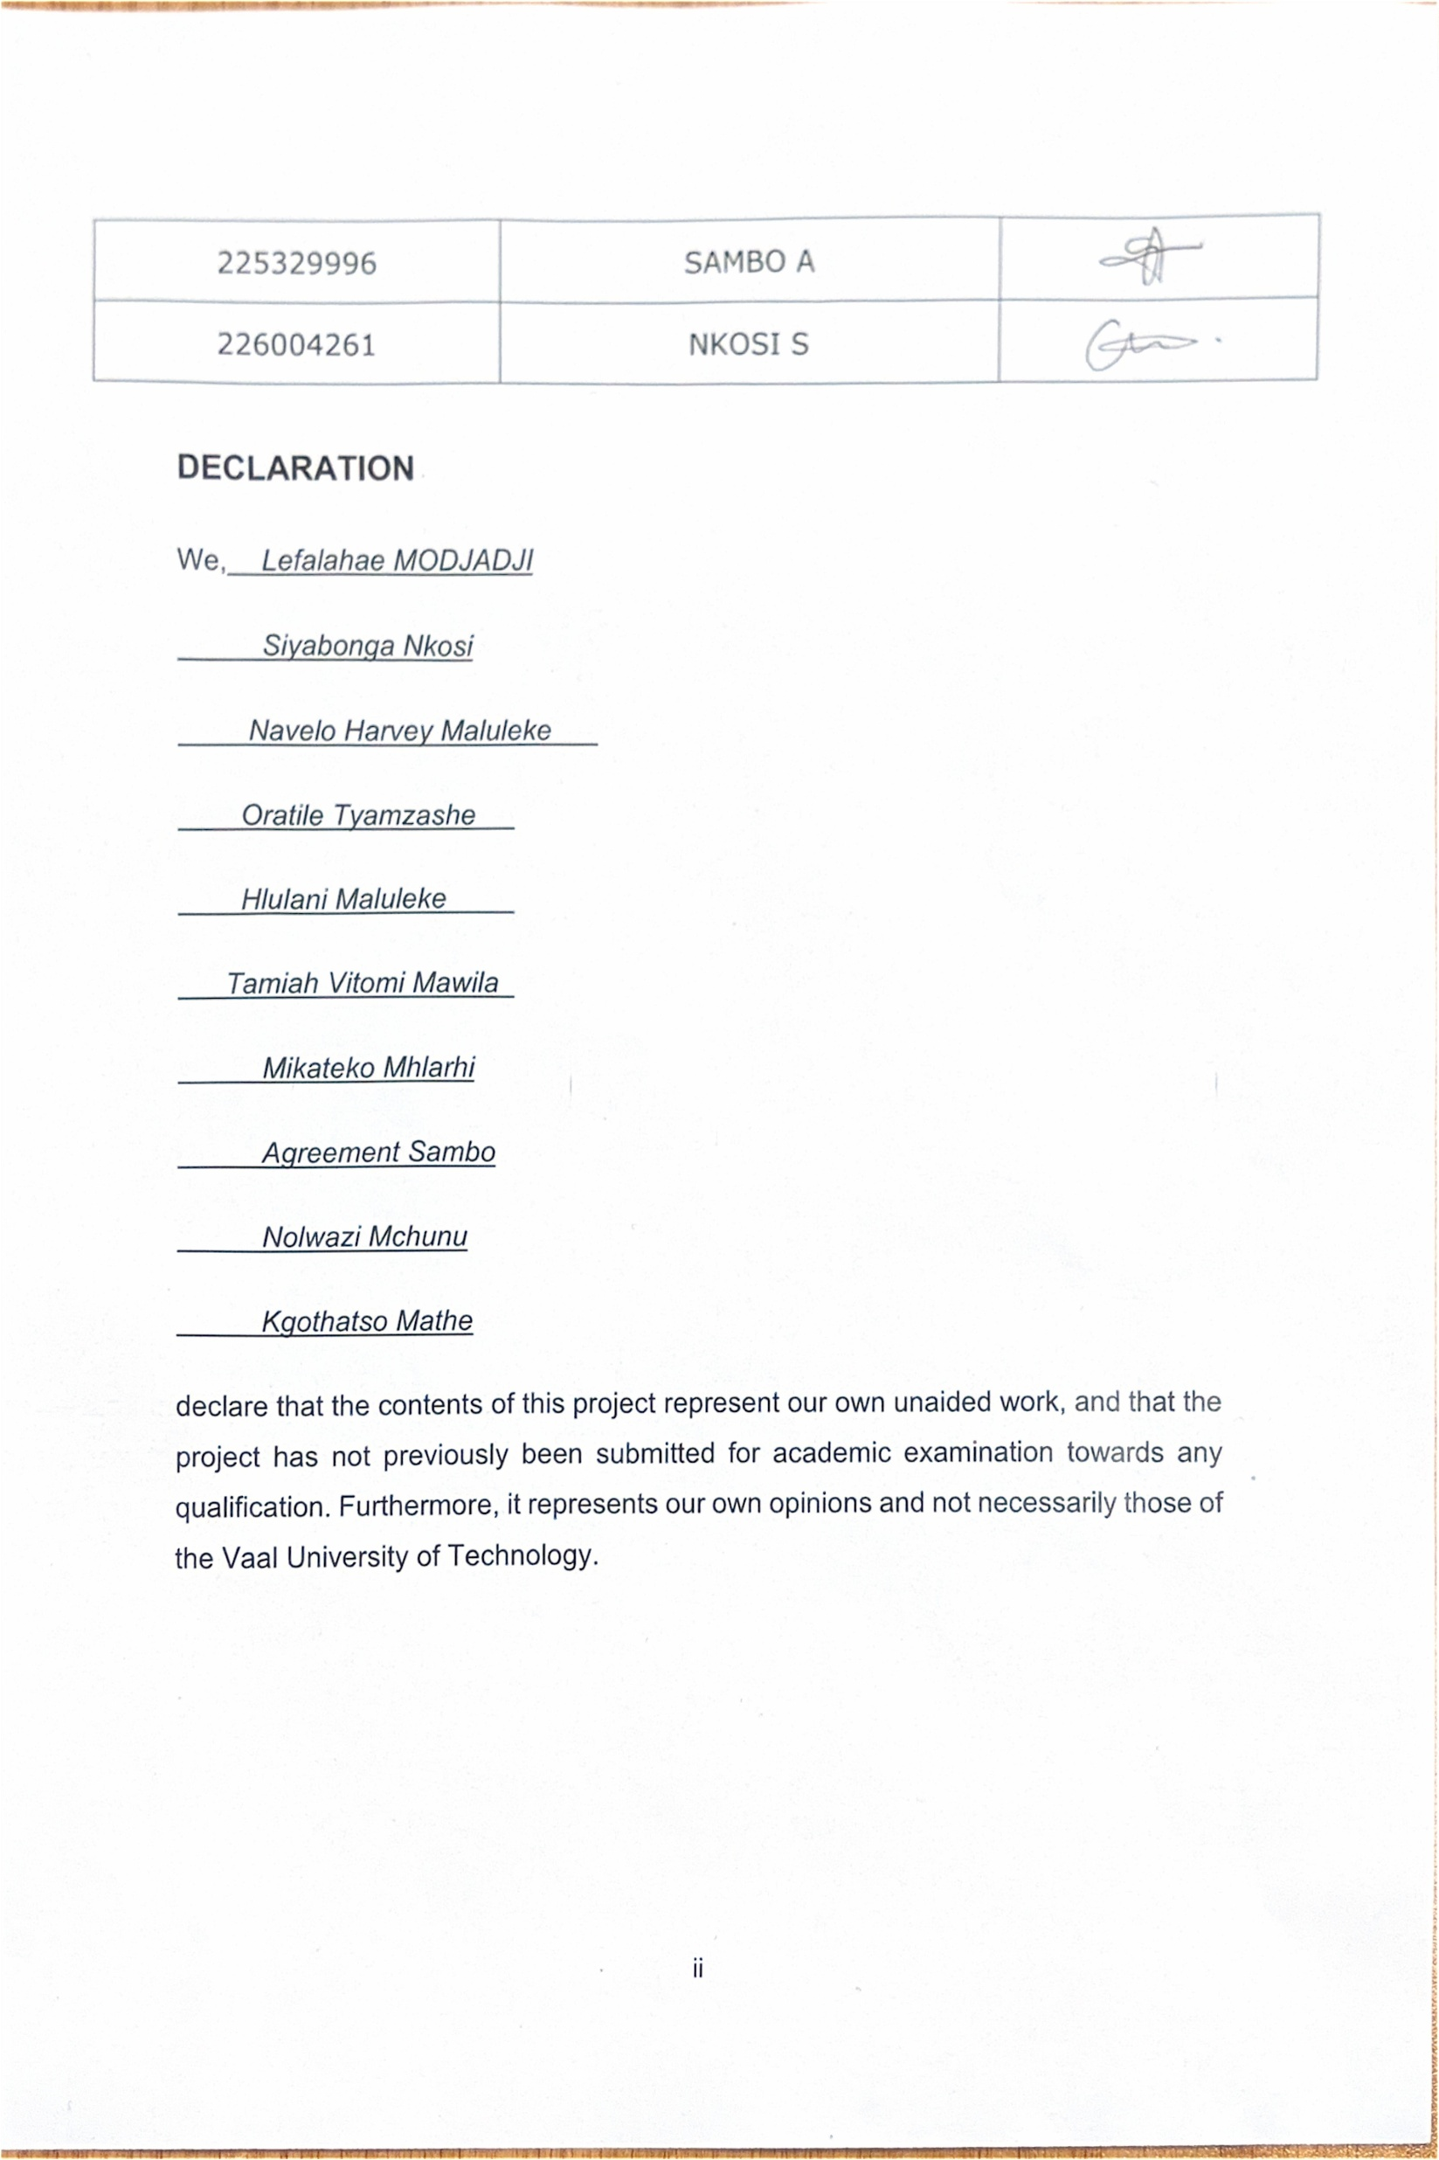
Declaration

Slide 3
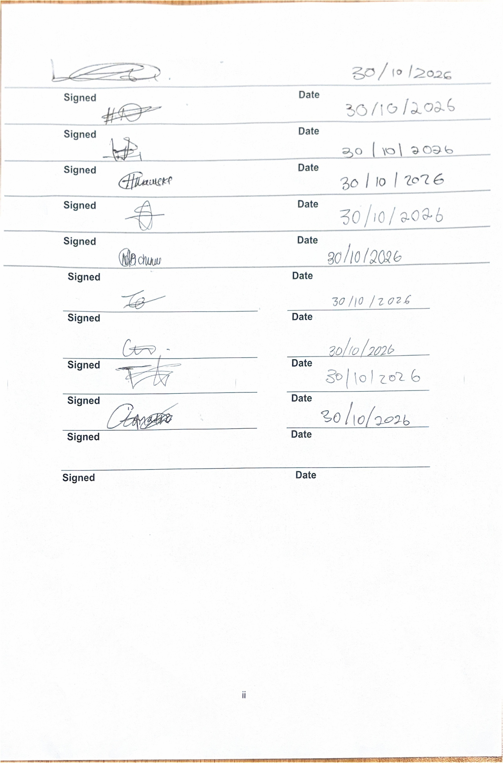
Declaration

Slide 4

G14 Hospital Management System
Group 14

Slide 5
The Scenario
Imagine a patient arriving at G14 Healthcare Facility in Vanderbijlpark, requiring medical attention. Before the healthcare worker can proceed, the patient's medical record must be located. However, because the facility relies on physical files and manual record-keeping finding the correct file may take longer than expected. Meanwhile, other patients continue arriving, queues become longer and staff face increasing pressure to assist everyone.

Slide 6
The Scenario (continued)
This situation highlights a challenge that many healthcare facilities can experience when managing large amounts of patient information using manual systems Delays in retrieving medical records can affect the patient experience and make it difficult for healthcare workers to access important information when they need it.
At G14, patient information, appointments, treatments, prescriptions and billing details are stored in physical documents and separate files. As the number of patients increases, managing these records becomes more difficult. Files may be misplaced or damaged, information may be incomplete and the same patient details may be recorded multiple times in different documents.

Slide 7
The Scenario (continued)
These challenges create additional work for administrative staff and may result in longer waiting times for patients. Healthcare workers may also struggle to obtain a complete view of a patient's medical history, particularly when information is spread across several files.
The main concern is that the current system makes it difficult for G14 to manage its growing information needs efficiently. Without a more organised approach, the facility may continue experiencing delays, data inconsistencies and difficulties maintaining accurate records

Slide 8
Introduction to the problem
G14 Healthcare Facility provides basic healthcare services to the Vanderbijlpark community. Its daily operations depend on accurate and accessible information to support patient care, appointment scheduling, treatment management, prescription records, billing and staff administration.
However, the facility's existing flat-file system is becoming less suitable as its patient population grows The system relies heavily on manual processes, making information difficult to retrieve, update and maintain consistently.

Slide 9
Introduction to the problem (continued)
As Group 14, we examined these challenges to understand how the current record-keeping approach affects the facility's operations. We identified several key problems that need to be addressed:
Slow information retrieval: Staff must manually search through physical files, delaying access to patient information.
Poor record storage: Paper documents occupy significant space and can be lost, damaged or misplaced
Data duplication: The same patient information may be recorded in appointment, treatment, prescription and billing files, wasting storage space and increasing the risk of inconsistencies

Slide 10
Introduction to the problem (continued)
Difficult information updates: Changes to patient details may need to be made across several files, creating opportunities for human error and outdated information.
Data integrity and security concerns: Maintaining complete, accurate and protected records becomes more difficult when information is scattered across physical documents
Inefficient reporting: Compiling reports and analysing facility operations is challenging when information is stored in separate files

Slide 11
Introduction to the problem (continued)
These problems affect more than the administrative side of the facility. They can contribute to patient frustration, increase staff workloads and limit the availability of information needed to support timely healthcare services
Our assessment showed that the underlying issue is the way information is organised and managed Adding more physical storage or continuing to rely on manual processes would not adequately address these limitations.
Group 14 therefore proposes a structured database solution designed around G14's information management needs. Our aim is to improve the organisation, accuracy and accessibility of records while creating a system that can support the facility as its operations expand

Slide 12
Proposed Solution
TO address the identified challenges, Group 14 proposes replacing G14's existing flat-file system with a relational database management system. This solution will organise the facility's information into structured, related tables rather than keeping records scattered across separate physical files
The proposed database will include tables for patients, doctors, appointments, treatments, prescriptions, bills and staff members. Each table will store information relevant to its purpose, while primary keys and foreign keys will establish relationships between the different types of records.
For example, a patients information can be linked to their appointments, treatments and prescriptions. This will make it easier for authorised staff to retrieve related Information without unnecessarily duplicating the patient's details in every record.

Slide 13
Proposed Solution(continued)
We will also apply database normalisation, progressing from Unnormalized Form (IJNF) through First Normal Form (INF) and Second Normal Form (2NF) to Third Normal Form (3NF). This process will help reduce unnecessary data duplication, improve consistency and maintain data integrity. In addition, appropriate access controls, security measures and backup procedures will be necessary to protect sensitive patient information. These measures will help ensure that information is accessible to authorised users while reducing the risks associated with loss or unauthorised access.

Slide 14
Proposed Solution(continued)
The expected outcome is a more efficient and reliable information management system that reduces the administrative burden, improves record organisation and supports better access to patient information. Although the database cannot independently guarantee shorter waiting times or better clinical outcomes, it can address important information management problems that contribute to operational delays.
In conclusion, Group 14's proposal focuses on solving the root cause Of G14’s record management challenges. By introducing a structured relational database, we aim to help the facility move away from inefficient manual processes towards a more organised, accurate and scalable system. This will provide a stronger foundation for managing growing patient numbers and supporting the delivery of reliable healthcare services to the community.

Slide 15
Business Rules
These business rules were acquired by interview managerial individuals of the facility, and consulting with targeted users as to improvements that would be appropriate
The following business rules describe how G14 Healthcare Facility operates and how data is managed within the proposed relational database system. These rules are designed to support day-to-day hospital operations

Slide 16
Business Rules(continued)
Patient Rules
BR1: Each patient should be identified by a PatientID.
BR2: A single patient could have one or more appointments with health care providers. BR3: Each appointment should have exactly one patient.
BR4: One person can receive health care services from one or more billing records.
BR5: A patient is allowed to be in the system without an appointment.

Slide 17
Business Rules(continued)
Staff Rules
BR6: Staff should all have their own StaffID.
BR7: All staff members should have a StaffType that specifies their role in the healthcare facility.
BR8: StaffType can be any of the following values:
Doctor
Nurse
Receptionist
Administrator
BR9: Staff person can be in multiple treatments.
BR10: Doctors and Nurses only can be assigned to treatments.
BR11: Receptionists and Administrators are not allowed to give treatments or to supervise them.

Slide 18
Business Rules(continued)
Appointment Rules
BR12: An AppointmentID is required to be unique for each appointment.
BR13: Each appointment is supposed to have one patient assigned to it.
BR14: Multiple dates and times can be planned for a patient.
BR15: Patient must be in system for an appointment to be created.
BR16: An appointment may lead to treatment without a hospital admission.
BR17: An appointment can yield 0 or 1 admissions.
BR18: A zero, one, or many prescriptions are possible to receive during an appointment.
BR19: The status of the appointment should be reflected in the appointment status.

Slide 19
Business Rules(continued)
Admission Rules
BR20: Must ensure that each admission has a unique AdmissionID.
BR21: All admissions should be from one appointment.
BR22: Each admission must be given to a room.
BR23: Not all appointments result in admissions.
BR24: No admission can be made without the existence of an appointment and room assignment.
BR25: Admission and discharge dates should be documented to be able to monitor patient's stay.
BR26: It is possible for a patient to have several admissions over time.

Slide 20
Business Rules(continued)
Ward Rules
BR27: Every ward should have a WardID.
BR28: A ward can have one or more rooms.
BR29: Each room should only be assigned to one ward.
BR30: A ward can have a number of rooms before being allocated.

Slide 21
Business Rules(continued)
Room Rules
BR31: All rooms need to be assigned a RoomID.
BR32: All rooms will need to be designated to a ward.
BR33: A room can be opened for several different admissions over time.
BR34: One patient can only be admitted to a room at a given time.
BR35: All rooms are required to have a RoomAvailability status.
BR36: RoomAvailability can have one of the following values:
Available
Occupied
BR37: A patient can only be put in a room that has the status "Available".
BR38: When the patient is admitted to the room, the status of the room should be set to "Occupied".
BR39: The room should be set to "Available" when the patient is discharged from the room.

Slide 22
Business Rules(continued)
Treatment Rules
BR40: Treatments must have a unique TreatmentID.
BR41: All treatments should have an appointment.
BR42: All treatments are to be carried out or supervised by one member of staff.
BR43: Depending on the patient, one or more treatments may be required for an appointment.
BR44: Record treatment details such as diagnosis and treatment description for all treatment given.
BR45: If there is no valid appointment, then there is no treatment.
BR46: A treatment may be provided to either an outpatient or an admitted patient.

Slide 23
Business Rules(continued)
Medicine Rules
BR47: A MedicineID should be unique for each medicine.
BR48: There must exist a MedicineName for every medicine.
BR49: Stock value should be assigned to every medicine to show the amount of medicine available.
BR50: A drug can be prescribed for several different prescriptions.
BR51: A medicine can be in the system without a prescription.
BR52: Stock levels should be adjusted whenever medication is supplied via a prescription.

Slide 24
Business Rules(continued)
Prescription Rules
BR53: A PrescriptionID must be unique for each prescription.
BR54: Each prescription should be linked to an appointment.
BR55: All prescriptions include one medicine.
BR56: There must be an appointment when a prescription is issued.
BR57: For every prescription there is a medicine that goes with it.
BR58: Multiple prescriptions can be issued for one appointment.
BR59: A Medicine can be issued on more than one Prescription.
BR60: There shall be records of dosage for each prescription.

Slide 25
Business Rules(continued)
Billing Rules
BR61: Each BillingRecord must be distinctively represented by a BillID.
BR62: Each bill must have the identifier of one patient.
BR63: A patient may have multiple billing records.
BR64: PaymentStatus is required to have one of the following values:
Paid
Pending
Overdue
BR65: Billing records shall be accurate to reflect services provided to the patient during the course of appointments, admissions, treatments and prescriptions.

Slide 26
Business Rules(continued)
Relationship and Cardinality Summary
One Patient can have many Appointments.
One Patient can have many Billing records.
One Appointment can have many Treatments.
One Appointment can have many Prescriptions.
Zero or one Admission can be created from one Appointment.
There may be several Rooms in each Ward.
One Room can accommodate many Admissions over time.
Many Treatments can be done by one Staff member.
One Medicine can be found in several Prescriptions.

Slide 27
Business Rules (Summary)
These business rules help to ensure that the proposed relational database will meet the business requirements of G14 Healthcare Facility. The rules define clearly the relationship between patients, appointments, admissions, wards, rooms, staff, treatments, medicines, prescriptions and billing records, while also guaranteeing data consistency, avoiding data duplication through Third Normal Form (3NF), and supporting both outpatient and inpatient healthcare services.

Slide 28
Database Normalization
Database normalization was done to convert the existing flat file system of the G14 Healthcare Facility into a structured relational database. This current flat-file system combines patient, staff, treatment, room and billing data all in the same file, which leads to duplicated records, inefficient data retrieval and challenges with data updates.
The normalization process was performed from First Normal Form (1NF) to Third Normal Form (3NF) in order to reduce data duplication, ensure data integrity and to design the database structure to meet the requirements of G14 Healthcare Facility's operations.

Slide 29
Unnormalized Form (UNF)
In the original flat-file system used by G14 Healthcare Facility, information relating to patients, appointments, admissions, rooms, wards, staff members, treatments, medicines, prescriptions and billing records was stored together in a single table.

Slide 30
UNF (continued) unnormarlized Data
PatientID | PatientName | AppointmentID | TreatmentID | PrescriptionID | MedicineName | WardName | BillAmount
P001 | John Smith | A001 | T001 | PR001 | Amlodipine | General | 1500
P001 | John Smith | A001 | T002 | PR002 | Aspirin | General | 1500
P002 | Mary Jones | A002 | T003 | PR003 | Paracetamol | Surgical | 2200
P003 | David Brown | A003 | T004 | PR004 | Metformin | ICU | 1800

Slide 31
UNF (continued)
Problems Identified
Patient information is repeated.
Appointment information is repeated.
Medicine information is repeated.
Billing information appears multiple times.
Data redundancy exists throughout the table.
Updating, deleting, or inserting data may result in inconsistent data(anomalies).

Slide 32
First Normal Form (1NF)
Examples:
Patient
PatientID | FirstName | LastName | PhoneNumber
P001 | John | Smith | 0823456789
P002 | Mary | Jones | 0834567890
P003 | David | Brown | 0845678901

Slide 33
First Normal Form (1NF)examples
Appointment
AppointmentID | PatientID | AppointmentDate | AppointmentTime | AppointmentStatus
A001 | P001 | 01/04/2026 | 08:00 | Completed
A002 | P002 | 03/04/2026 | 09:30 | Completed
A003 | P003 | 05/04/2026 | 10:00 | Completed

Slide 34
First Normal Form (1NF) examples
Admission
AdmissionID | AppointmentID | PatientID | RoomID | AdmissionDate | DischargeDate
AD001 | A001 | P001 | R01 | 01/04/2026 | 05/04/2026
AD002 | A002 | P002 | R02 | 03/04/2026 | 07/04/2026

Slide 35
First Normal Form (1NF) examples
Treatment
TreatmentID | AppointmentID | StaffID | Diagnosis
T001 | A001 | S001 | Hypertension
T002 | A001 | S002 | Monitoring
T003 | A002 | S003 | Influenza

Slide 36
First Normal Form (1NF) examples
Medicine
MedicineID | MedicineName | Stock
M001 | Amlodipine | 150
M002 | Aspirin | 300
M003 | Paracetamol | 500

Slide 37
First Normal Form (1NF) examples
Prescription
PrescriptionID | AppointmentID | MedicineID | Dosage
PR001 | A001 | M001 | 5mg Daily
PR002 | A001 | M002 | 100mg Daily
PR003 | A002 | M003 | 500mg Every 6 Hours

Slide 38
1NF Outcomes
After going through 1NF there following improvements are noted:
Repeating groups were eliminated.
Atomic values were enforced.
Each row became uniquely identifiable.
Data became easier to manage.

Slide 39
Second Normal Form(2NF)
To achieve Second Normal Form (2NF), all non-key attributes are made to be dependent the primary keys.
Examples of the tables in 2NF:
Staff
StaffID | StaffType | Initials | PhoneNumber
S001 | Doctor | JM | 1236547890
S002 | Nurse | PN | 0174852369
S003 | Doctor | LK | 0321458796

Slide 40
2NF (Examples)
Ward
WardID | WardName
W01 | General
W02 | Surgical
W03 | ICU

Slide 41
2NF (cont)
Billing
BillID | PatientID | Amount | PaymentStatus
B001 | P001 | 1500 | Paid
B002 | P002 | 2200 | Pending
B003 | P003 | 1800 | Paid

Slide 42
2NF (cont)
Room
RoomID | WardID | WardName | RoomNumber | RoomAvailability
R01 | W01 | General | 101 | Occupied
R02 | W02 | Pediatrics | 201 | Occupied
R03 | W01 | General | 102 | Occupied
R04 | W03 | Surgical | 301 | Occupied
R05 | W02 | Pediatrics | 202 | Occupied

Slide 43
2NF (cont)
After the 2NF stage, non-key attributes are depended on the primary keys of they’re entries and the following improvements can be seen:
Partial dependencies were removed.
Data was separated into subject-specific entities.
Medicine information was no longer duplicated.
Prescription management improved.
Data redundancy was significantly reduced.
But a problem still exists on the Room table; Although data duplication has largely been removed, WardName is still dependent on WardID rather than RoomID, creating a transitive dependency, thus violating 3NF.this takes us to the next step 3NF.

Slide 44
Third Normal Form (3NF)
To achieve Third Normal Form (3NF), all transitive dependencie are removed. That leaves us with the following table structure:
Room
The transistive dependency is removed, thus achieving 3NF.
RoomID | WardID | RoomNumber | RoomAvailability
R01 | W01 | 101 | Occupied
R02 | W02 | 201 | Occupied
R03 | W01 | 102 | Occupied
R04 | W03 | 301 | Occupied
R05 | W02 | 202 | Occupied

Slide 45
Final 3NF Relations
Entities | Attributes
Patient | PatientID (PK), FirstName, LastName, PhoneNumber
Appointment | AppointmentID (PK), PatientID (FK), AppointmentDate, AppointmentTime, AppointmentStatus
Admission | AdmissionID (PK), AppointmentID (FK), PatientID (FK), RoomID (FK), AdmissionDate, DischargeDate
Ward | WardID (PK), WardName
Room | RoomID (PK), WardID (FK), RoomNumber, RoomAvailability
Staff | StaffID (PK), StaffType, Initials
Treatment | TreatmentID (PK), AppointmentID (FK), StaffID (FK), Diagnosis, TreatmentDescription
Medicine | MedicineID (PK), MedicineName, Stock
Prescription | PrescriptionID (PK), AppointmentID (FK), MedicineID (FK), Dosage
Billing | BillID (PK), PatientID (FK), Amount, PaymentStatus

Slide 46
3NF (cont): Outcomes
We achieve the following because of 3NF:
Repeating groups are eliminated.
Partial dependencies are removed.
Transitive dependencies are removed.
Medicine data is separated from prescription data.
Appointment information was stored once.
Foreign keys link related tables.
Data integrity is improved.
Redundancy was minimized throughout the database.

Slide 47
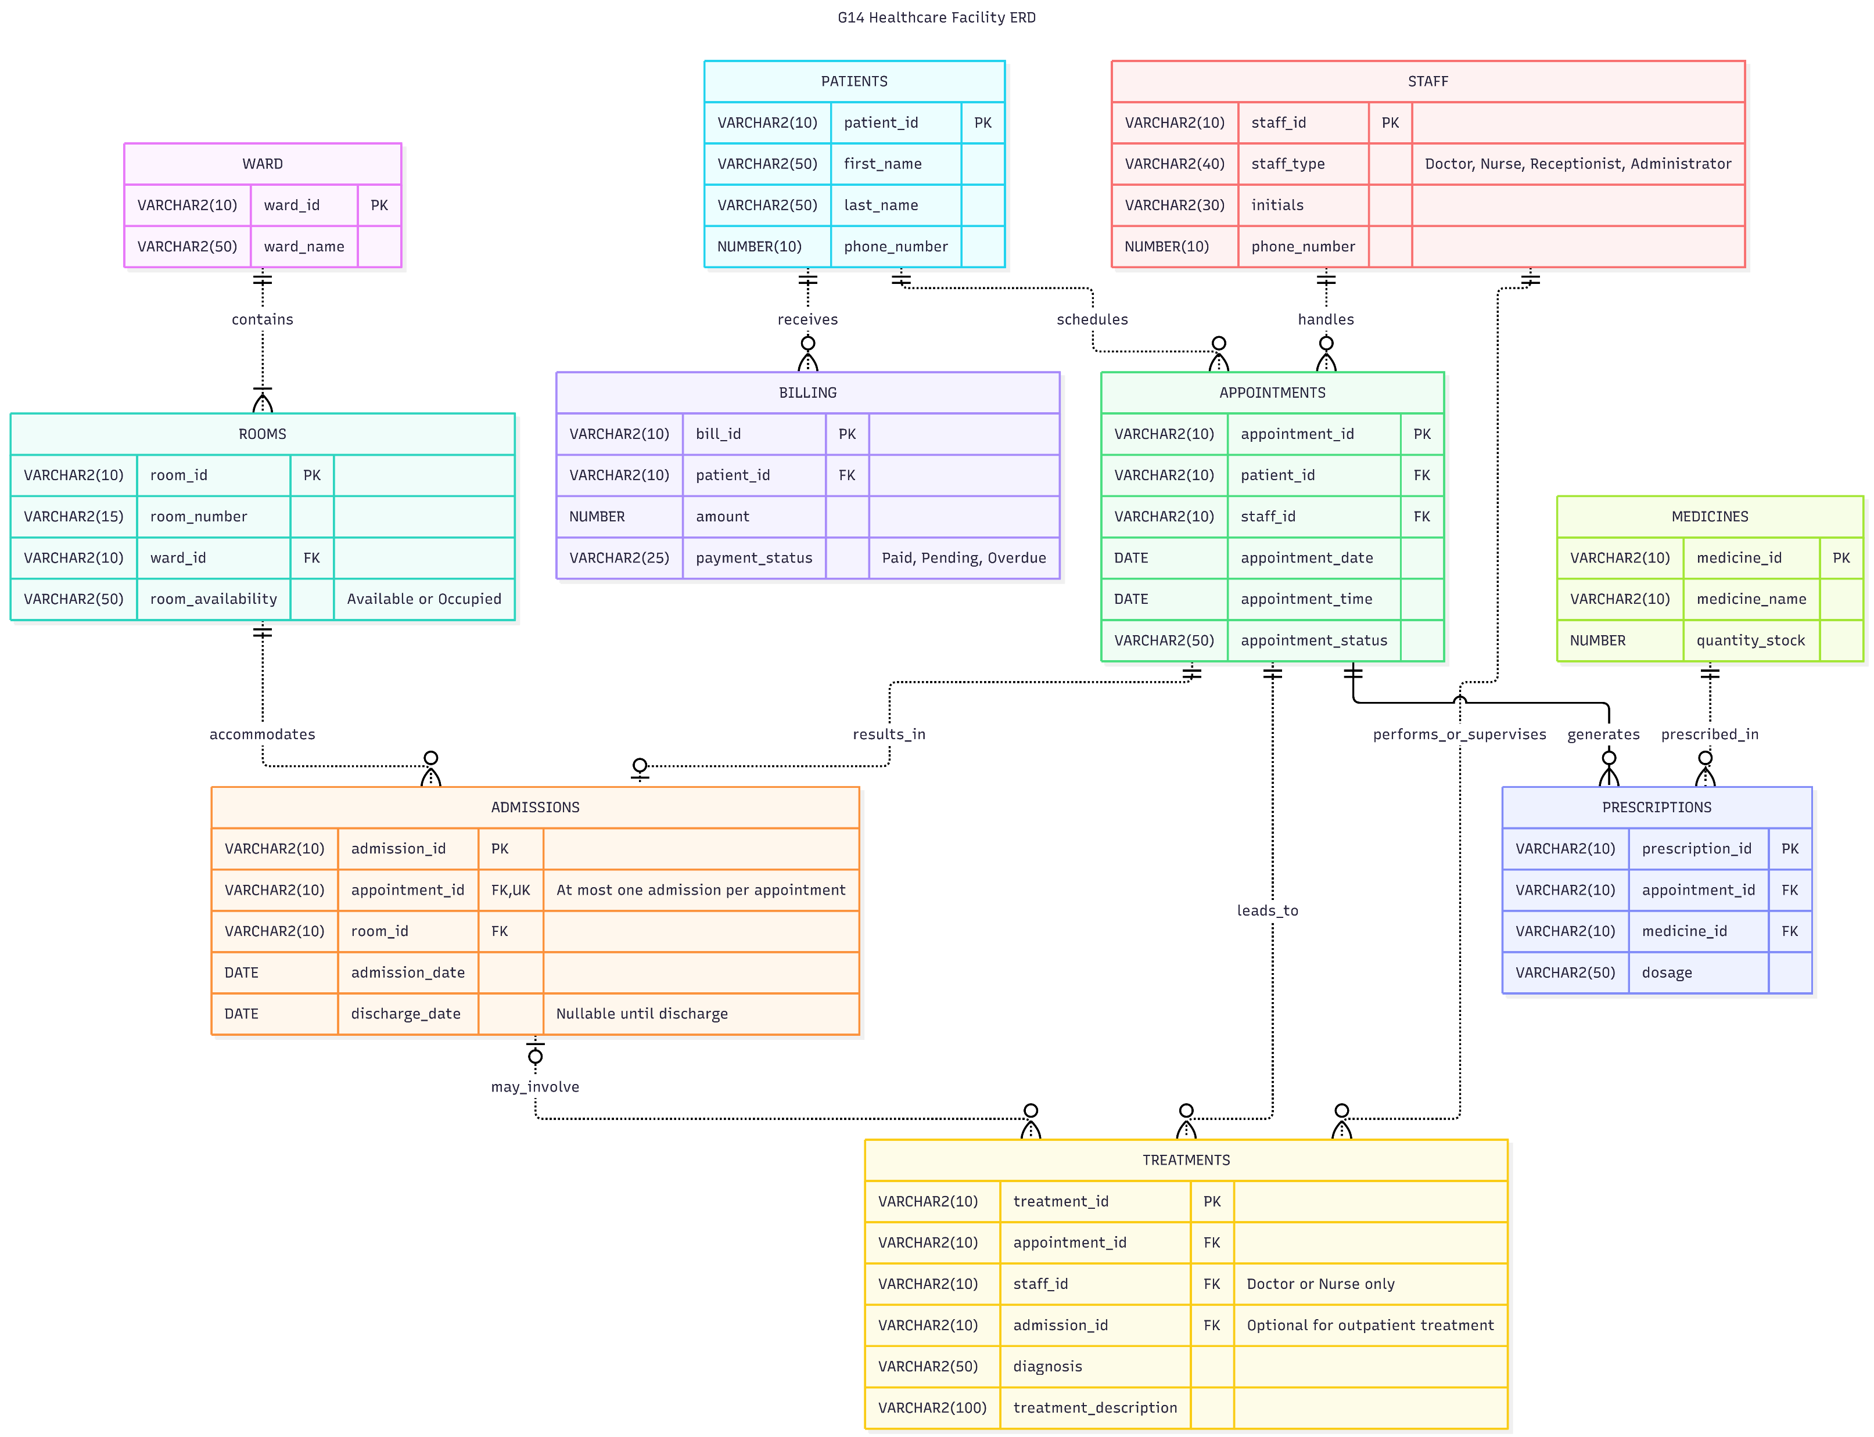
The Resulting ERD

Slide 48
Normalization Summary
The G14 Healthcare Facility database was normalized from Unnormalized Form (UNF) through First Normal Form (1NF), Second Normal Form (2NF), and finally Third Normal Form (3NF). The normalization process eliminated redundant data, improved consistency, and ensured efficient data storage. The final database structure provides an integrated solution for managing patients, appointments, admissions, wards, rooms, staff members, treatments, medicines, prescriptions, and billing records while supporting both outpatient and inpatient healthcare services.
With the database of G14 normalized we can move to the implementation or testing of the physical database.

Slide 49
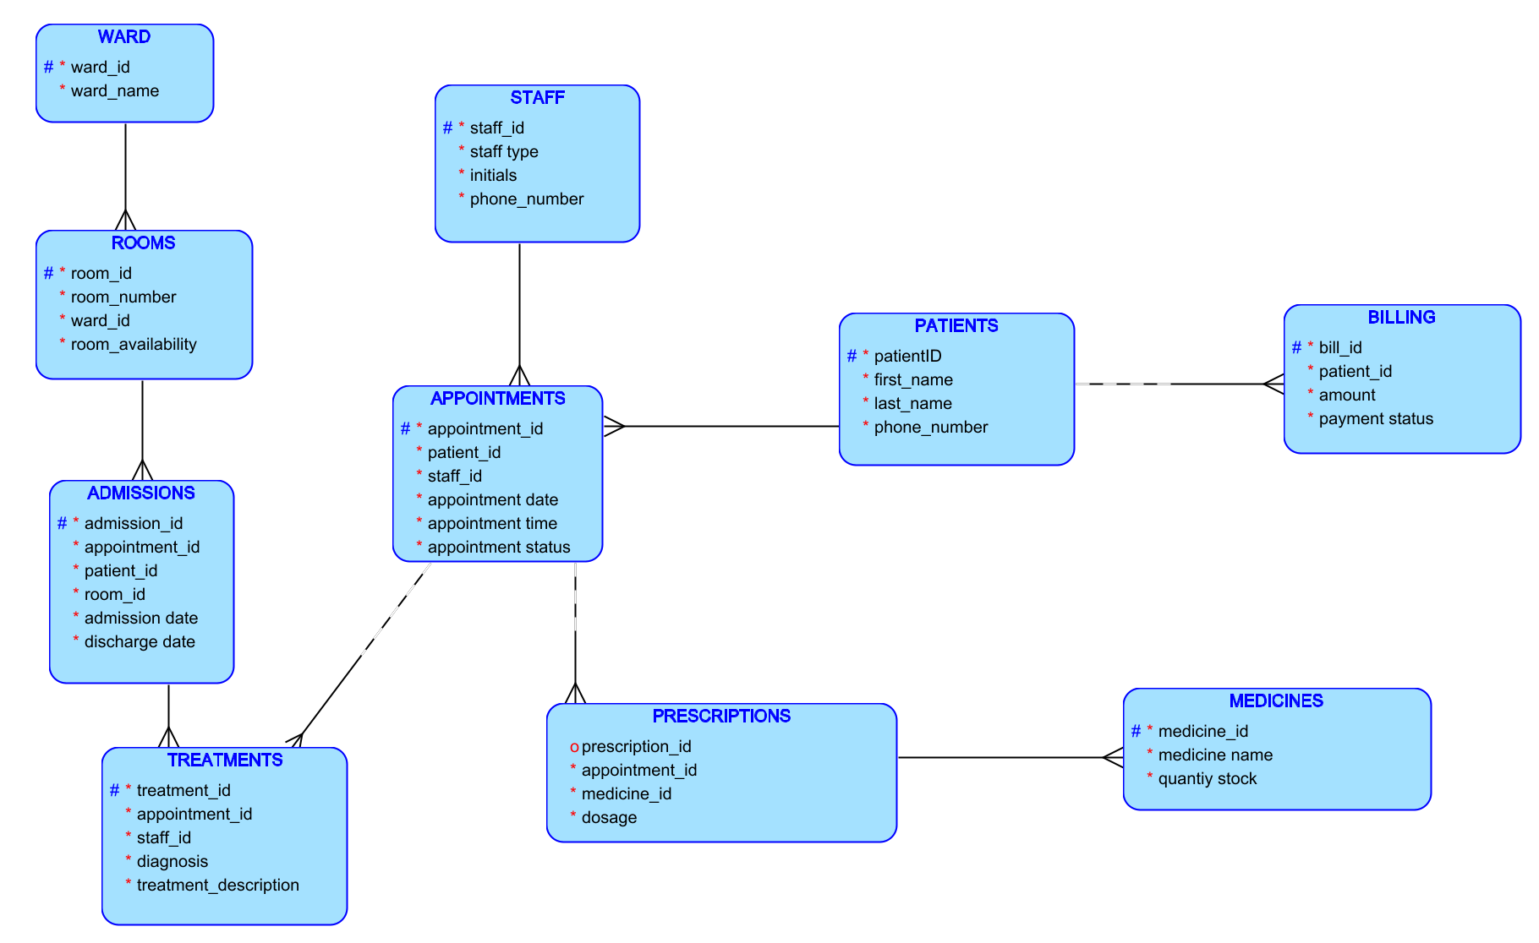
ERD (Planning) :Logical

Slide 50
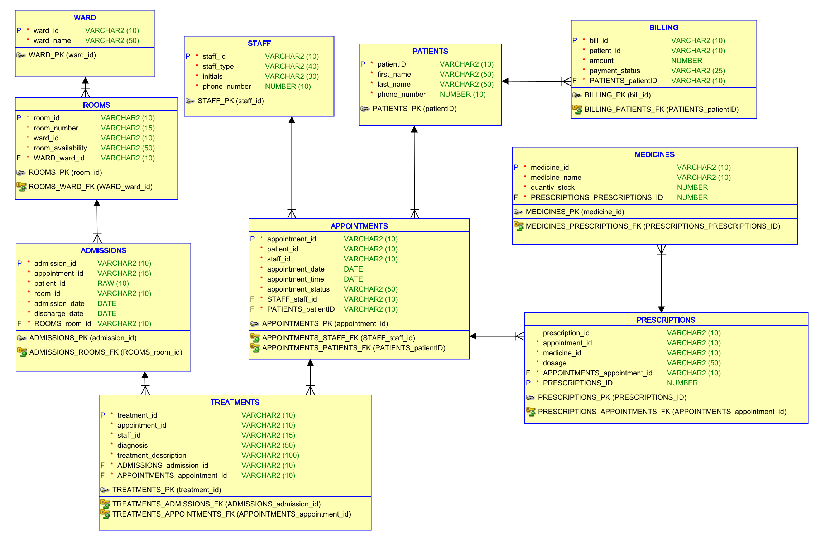
ERD (Relational)

Slide 51
ERD (with crows foot notation)

Slide 52
SQL (Creating Tables)
-- PATIENTS
-- ==========================================
CREATE TABLE PATIENTS (
patient_id VARCHAR(10) NOT NULL,
first_name VARCHAR(50) NOT NULL,
last_name VARCHAR(50) NOT NULL,
phone_number VARCHAR(10) NOT NULL,
CONSTRAINT PATIENTS_PK
PRIMARY KEY (patient_id)
);
-- ==========================================

Slide 53
SQL (Creating Tables
-- ==========================================
-- STAFF
-- ==========================================
CREATE TABLE STAFF (
staff_id VARCHAR(10) NOT NULL,
staff_type VARCHAR(40) NOT NULL,
initials VARCHAR(30) NOT NULL,
phone_number VARCHAR(10),
CONSTRAINT STAFF_PK
PRIMARY KEY (staff_id)
);
-- ==========================================

Slide 54
SQL (Creating Tables
-- WARD
-- ==========================================
CREATE TABLE WARD (
ward_id VARCHAR(10) NOT NULL,
ward_name VARCHAR(50) NOT NULL,
CONSTRAINT WARD_PK
PRIMARY KEY (ward_id)
);
-- ==========================================

Slide 55
SQL (Creating Tables
-- ROOMS
-- ==========================================
CREATE TABLE ROOMS (
room_id VARCHAR(10) NOT NULL,
room_number VARCHAR(15) NOT NULL,
ward_id VARCHAR(10) NOT NULL,
room_availability VARCHAR(50) NOT NULL,

Slide 56
SQL (Creating Tables)rooms cont
CONSTRAINT ROOMS_PK
PRIMARY KEY (room_id),
CONSTRAINT ROOMS_WARD_FK
FOREIGN KEY (ward_id)
REFERENCES WARD (ward_id),
CONSTRAINT ROOM_STATUS_CHK
CHECK (
room_availability IN (
'Available',
'Occupied'
)
)
);
-- ==========================================

Slide 57
SQL (Creating Tables
-- APPOINTMENTS
-- ==========================================
CREATE TABLE APPOINTMENTS (
appointment_id VARCHAR(10) NOT NULL,
patient_id VARCHAR(10) NOT NULL,
appointment_date DATE NOT NULL,
appointment_time VARCHAR(20) NOT NULL,
appointment_status VARCHAR(50) NOT NULL,
CONSTRAINT APPOINTMENTS_PK
PRIMARY KEY (appointment_id),
CONSTRAINT APPOINTMENTS_PATIENT_FK
FOREIGN KEY (patient_id)
REFERENCES PATIENTS (patient_id)
);
-- ==========================================

Slide 58
SQL (Creating Tables
-- ==========================================
-- ADMISSIONS
-- ==========================================
CREATE TABLE ADMISSIONS (
admission_id VARCHAR(10) NOT NULL,
appointment_id VARCHAR(10) NOT NULL,
patient_id VARCHAR(10) NOT NULL,
room_id VARCHAR(10) NOT NULL,
admission_date DATE NOT NULL,
discharge_date DATE NOT NULL,
CONSTRAINT ADMISSIONS_PK
PRIMARY KEY (admission_id),

Slide 59
SQL (Creating Tables)admissions cont
CONSTRAINT ADMISSIONS_APPOINTMENT_FK
FOREIGN KEY (appointment_id)
REFERENCES APPOINTMENTS (appointment_id),
CONSTRAINT ADMISSIONS_PATIENT_FK
FOREIGN KEY (patient_id)
REFERENCES PATIENTS (patient_id),
CONSTRAINT ADMISSIONS_ROOM_FK
FOREIGN KEY (room_id)
REFERENCES ROOMS (room_id)
);
-- ==========================================

Slide 60
SQL (Creating Tables
-- TREATMENTS
-- ==========================================
CREATE TABLE TREATMENTS (
treatment_id VARCHAR(10) NOT NULL,
appointment_id VARCHAR(10) NOT NULL,
staff_id VARCHAR(10) NOT NULL,
diagnosis VARCHAR(100) NOT NULL,
treatment_description VARCHAR(200) NOT NULL,

Slide 61
SQL (Creating Tables)treatments cont
CONSTRAINT TREATMENTS_PK
PRIMARY KEY (treatment_id),
CONSTRAINT TREATMENTS_APPOINTMENT_FK
FOREIGN KEY (appointment_id)
REFERENCES APPOINTMENTS (appointment_id),
CONSTRAINT TREATMENTS_STAFF_FK
FOREIGN KEY (staff_id)
REFERENCES STAFF (staff_id)
);
-- ==========================================

Slide 62
SQL (Creating Tables
-- MEDICINES
-- ==========================================
CREATE TABLE MEDICINES (
medicine_id VARCHAR(10) NOT NULL,
medicine_name VARCHAR(50) NOT NULL,
stock NUMBER NOT NULL,
CONSTRAINT MEDICINES_PK
PRIMARY KEY (medicine_id)
);
-- ==========================================

Slide 63
SQL (Creating Tables
-- PRESCRIPTIONS
-- ==========================================
CREATE TABLE PRESCRIPTIONS (
prescription_id VARCHAR(10) NOT NULL,
appointment_id VARCHAR(10) NOT NULL,
medicine_id VARCHAR(10) NOT NULL,
dosage VARCHAR(50) NOT NULL,

Slide 64
SQL (Creating Tables)prescription cont
CONSTRAINT PRESCRIPTIONS_PK
PRIMARY KEY (prescription_id),
CONSTRAINT PRESCRIPTIONS_APPOINTMENT_FK
FOREIGN KEY (appointment_id)
REFERENCES APPOINTMENTS (appointment_id),
CONSTRAINT PRESCRIPTIONS_MEDICINE_FK
FOREIGN KEY (medicine_id)
REFERENCES MEDICINES (medicine_id)
);
-- ==========================================

Slide 65
SQL (Creating Tables
-- BILLING
-- ==========================================
CREATE TABLE BILLING (
bill_id VARCHAR(10) NOT NULL,
patient_id VARCHAR(10) NOT NULL,
amount NUMBER(10,2) NOT NULL,
payment_status VARCHAR(25) NOT NULL,
CONSTRAINT BILLING_PK
PRIMARY KEY (bill_id),
CONSTRAINT BILLING_PATIENT_FK
FOREIGN KEY (patient_id)
REFERENCES PATIENTS (patient_id)
);
-- ==========================================

Slide 66
SQL (Check Constraints)
-- CHECK CONSTRAINTS
-- ==========================================
ALTER TABLE STAFF
ADD CONSTRAINT STAFF_TYPE_CHK
CHECK (
staff_type IN
(
'Doctor',
'Nurse',
'Receptionist',
'Administrator'
)
);

Slide 67
SQL (Check Constraints)
ALTER TABLE BILLING
ADD CONSTRAINT PAYMENT_STATUS_CHK
CHECK (
payment_status IN
(
'Paid',
'Pending',
'Overdue'
)
);
-- ==========================================
-- END OF SCRIPT
-- ==========================================

Slide 68
SQL (Insert Values into Tables)
PATIENTS
INSERT INTO PATIENTS
VALUES ('P001','JOHN','DOE','0720017896');
INSERT INTO PATIENTS
VALUES ('P002','JANE','DOE','0620017894');
INSERT INTO PATIENTS
VALUES ('P003','JOSE','FLICK','0745236987');
INSERT INTO PATIENTS
VALUES ('P004','LILY','SMITH','0147852369');

Slide 69
SQL (Insert Values into Tables)
INSERT INTO PATIENTS
VALUES ('P005','WILL','FOSTER','3216547899');
INSERT INTO PATIENTS
VALUES ('P006','KATLEGO','DUBE','369963258');
INSERT INTO PATIENTS
VALUES ('P007','MINKATEKO','MAHLANGU','1478523690');
INSERT INTO PATIENTS
VALUES ('P008','KATE','NDLOVU','2587419630');
INSERT INTO PATIENTS
VALUES ('P009','BIG','JOHN','3217896540');

Slide 70
SQL (Insert Values into Tables)
STAFF
INSERT INTO STAFF
VALUES ('SD001', 'Doctor', 'DR N NAIDOO', '1478523690');
INSERT INTO STAFF
VALUES ('SN001 ', 'Nurse', 'L.MAHLANGU ', '0789825530');
INSERT INTO STAFF
VALUES ('SN002 ', 'Nurse', 'MN.SMITH ', '0780789681');
INSERT INTO STAFF
VALUES (' SN003', 'Nurse', 'G.OLESENG ', '0748596321');

Slide 71
SQL (Insert Values into Tables)
INSERT INTO STAFF
VALUES (' SD002', 'Doctor', 'DR.L.SMITH ', '0147741025');
INSERT INTO STAFF
VALUES (' SD003', 'Dcotor', 'DR J.DOE ', '3698520147');
INSERT INTO STAFF
VALUES (' SA001', 'Administrator', 'N.MOKOENA ', '3698520147');
INSERT INTO STAFF
VALUES (' SA002', 'Administrator', 'K.NAUME ', '3217896691');
INSERT INTO STAFF
VALUES (' SR001', 'Receptionist', 'L.HOLLY ', '9632587410');

Slide 72
SQL (Insert Values into Tables)
WARD
INSERT INTO WARD VALUES ('W01', 'General');
INSERT INTO WARD VALUES ('W02', 'Surgical');
INSERT INTO WARD VALUES ('W03', 'ICU');

Slide 73
SQL (Insert Values into Tables)
ROOMS
INSERT INTO ROOMS VALUES ('R01', '101', 'W01', 'Occupied');
INSERT INTO ROOMS VALUES ('R02', '201', 'W02', 'Occupied');
INSERT INTO ROOMS VALUES ('R03', '102', 'W01', 'Available');
INSERT INTO ROOMS VALUES ('R04', '301', 'W03', 'Occupied');
INSERT INTO ROOMS VALUES ('R05', '202', 'W02', 'Available');

Slide 74
SQL (Insert Values into Tables)
APPOINTMENTS
INSERT INTO APPOINTMENTS
VALUES ('A001','P001',TO_DATE('01-04-2026','DD-MM-YYYY'),'08:00','Completed');
INSERT INTO APPOINTMENTS
VALUES ('A002','P002',TO_DATE('03-04-2026','DD-MM-YYYY'),'09:30','Completed');
INSERT INTO APPOINTMENTS
VALUES ('A003','P003',TO_DATE('05-04-2026','DD-MM-YYYY'),'10:00','Completed');
INSERT INTO APPOINTMENTS
VALUES ('A004','P004',TO_DATE('08-04-2026','DD-MM-YYYY'),'11:00','Scheduled');

Slide 75
SQL (Insert Values into Tables)
INSERT INTO APPOINTMENTS
VALUES ('A005','P005',TO_DATE('09-04-2026','DD-MM-YYYY'),'13:00','Completed');
INSERT INTO APPOINTMENTS
VALUES ('A006','P006',TO_DATE('10-04-2026','DD-MM-YYYY'),'14:30','Scheduled');
INSERT INTO APPOINTMENTS
VALUES ('A007','P007',TO_DATE('11-04-2026','DD-MM-YYYY'),'15:00','Cancelled');
INSERT INTO APPOINTMENTS
VALUES ('A008','P008',TO_DATE('12-04-2026','DD-MM-YYYY'),'09:00','Completed');

Slide 76
SQL (Insert Values into Tables)
ADMISSIONS
(note that not all appointments lead to admission)
INSERT INTO ADMISSIONS
VALUES ('AD001','A001','P001','R01',
TO_DATE('01-04-2026','DD-MM-YYYY'),
TO_DATE('05-04-2026','DD-MM-YYYY'));
INSERT INTO ADMISSIONS
VALUES ('AD002','A002','P002','R02',

Slide 77
SQL (Insert Values into Tables)
TO_DATE('03-04-2026','DD-MM-YYYY'),
TO_DATE('07-04-2026','DD-MM-YYYY'));
INSERT INTO ADMISSIONS
VALUES ('AD003','A005','P005','R04',
TO_DATE('09-04-2026','DD-MM-YYYY'),
TO_DATE('12-04-2026','DD-MM-YYYY'));

Slide 78
SQL (Insert Values into Tables)
TREATMENTS
INSERT INTO TREATMENTS
VALUES ('T001','A001','SD001',
'Hypertension',
'Blood pressure treatment and monitoring');
INSERT INTO TREATMENTS
VALUES ('T002','A001','SN001',
'Observation',
'Patient vital signs monitored');
INSERT INTO TREATMENTS
VALUES ('T003','A002','SD002',
'Influenza',
'Antiviral treatment prescribed');

Slide 79
SQL (Insert Values into Tables)
INSERT INTO TREATMENTS
VALUES ('T004','A003','SD001',
'Diabetes',
'Blood glucose assessment');
INSERT INTO TREATMENTS
VALUES ('T005','A005','SN002',
'Post-operative Care',
'Routine monitoring after surgery');
INSERT INTO TREATMENTS
VALUES ('T006','A008','SD002',
'Respiratory Infection',

Slide 80
SQL (Insert Values into Tables)
MEDICINES
INSERT INTO MEDICINES
VALUES ('M001','Amlodipine',150);
INSERT INTO MEDICINES
VALUES ('M002','Aspirin',300);
INSERT INTO MEDICINES
VALUES ('M003','Paracetamol',500);
INSERT INTO MEDICINES
VALUES ('M004','Metformin',250);

Slide 81
SQL (Insert Values into Tables)
INSERT INTO MEDICINES
VALUES ('M005','Amoxicillin',200);
INSERT INTO MEDICINES
VALUES ('M006','Panado',50);
INSERT INTO MEDICINES
VALUES ('M007,'Grandpa',10);
INSERT INTO MEDICINES
VALUES ('M008','Benelin',80);

Slide 82
SQL (Insert Values into Tables)
PRESCRIPTIONS
INSERT INTO PRESCRIPTIONS
VALUES ('PR001','A001','M001','5mg Daily');
INSERT INTO PRESCRIPTIONS
VALUES ('PR002','A001','M002','100mg Daily');
INSERT INTO PRESCRIPTIONS
VALUES ('PR003','A002','M003','500mg Every 6 Hours');
INSERT INTO PRESCRIPTIONS
VALUES ('PR004','A003','M004','500mg Twice Daily');
INSERT INTO PRESCRIPTIONS
VALUES ('PR005','A005','M002','75mg Daily');
INSERT INTO PRESCRIPTIONS
VALUES ('PR006','A008','M005','500mg Three Times Daily');

Slide 83
SQL (Insert Values into Tables)
BILLING
INSERT INTO BILLING
VALUES ('B001','P001',1500.00,'Paid');
INSERT INTO BILLING
VALUES ('B002','P002',2200.00,'Pending');
INSERT INTO BILLING
VALUES ('B003','P003',1800.00,'Paid');
INSERT INTO BILLING
VALUES ('B004','P004',750.00,'Pending');

Slide 84
SQL (Insert Values into Tables)
INSERT INTO BILLING
VALUES ('B005','P005',3200.00,'Paid');
INSERT INTO BILLING
VALUES ('B006','P006',600.00,'Pending');
INSERT INTO BILLING
VALUES ('B007','P008',1250.00,'Overdue');
INSERT INTO BILLING
VALUES ('B008','P009',950.00,'Pending');

Slide 85
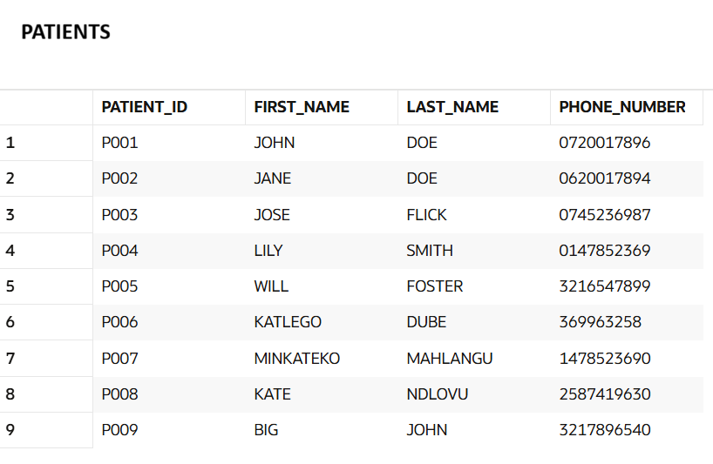
SQL (Query Results From Oracle LiveSql)
(screenshot)

Slide 86
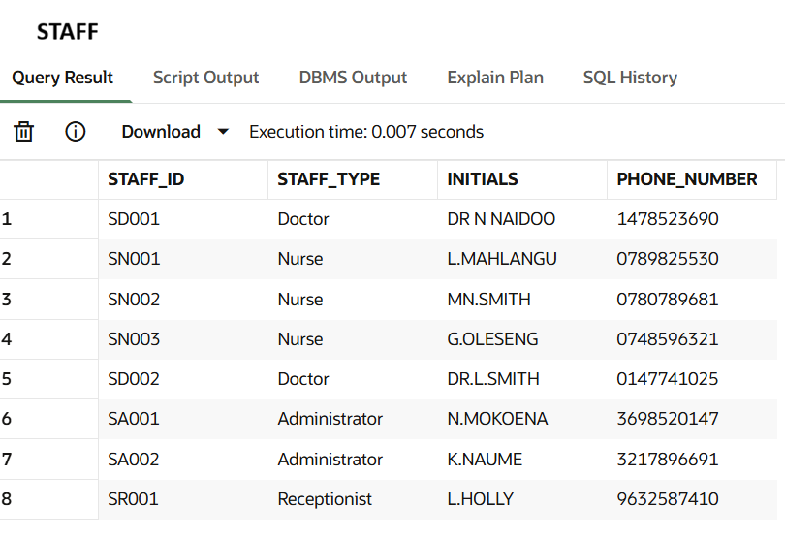
SQL (Query Results From Oracle LiveSql)
(screenshot)

Slide 87
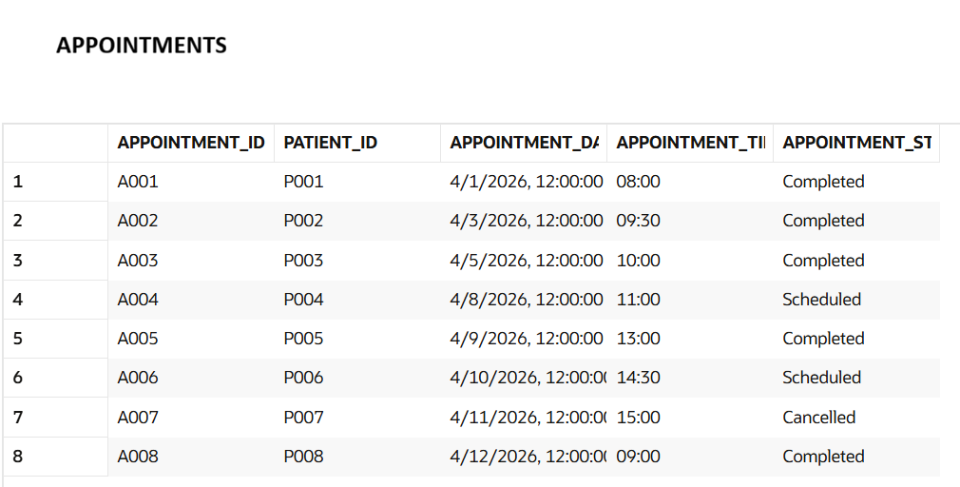
SQL (Query Results From Oracle LiveSql)
(screenshot)

Slide 88
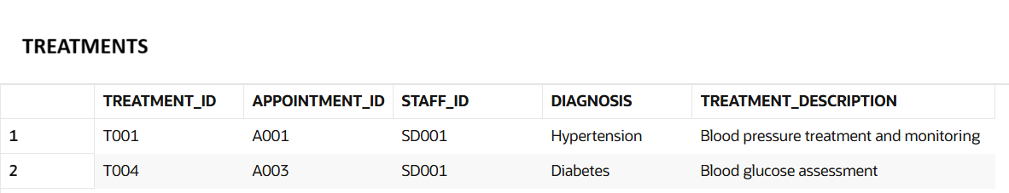
SQL (Query Results From Oracle LiveSql)
(screenshot)

Slide 89
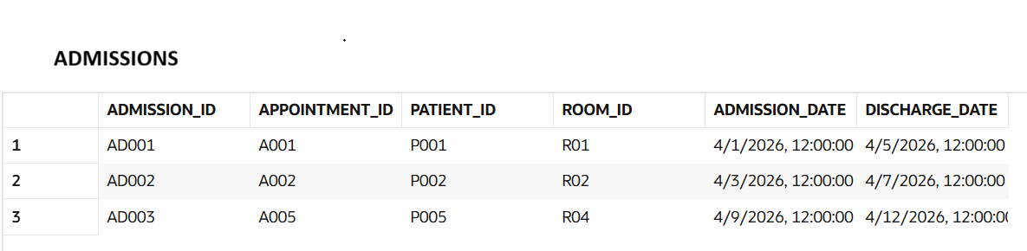
SQL (Query Results From Oracle LiveSql)
(screenshot)

Slide 90
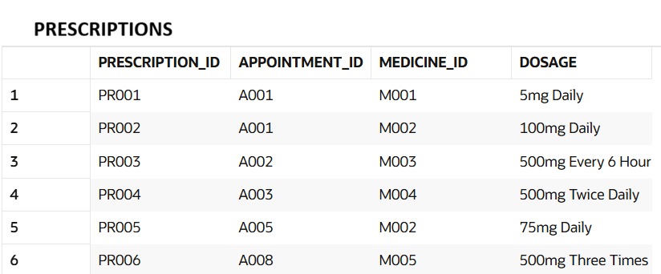
SQL (Query Results From Oracle LiveSql)
(screenshot)

Slide 91
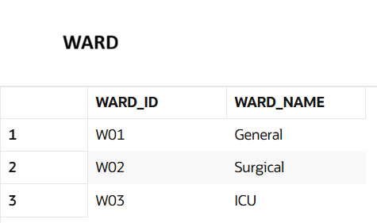
SQL (Query Results From Oracle LiveSql)
(screenshot)

Slide 92
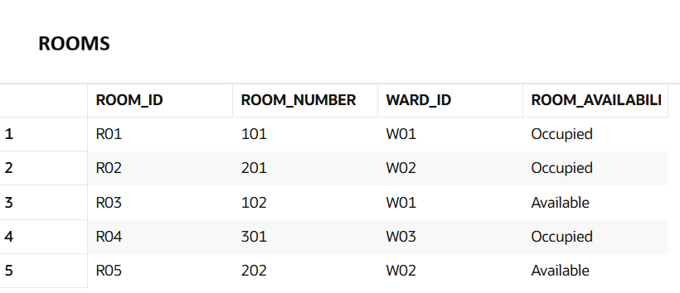
SQL (Query Results From Oracle LiveSql)
(screenshot)

Slide 93
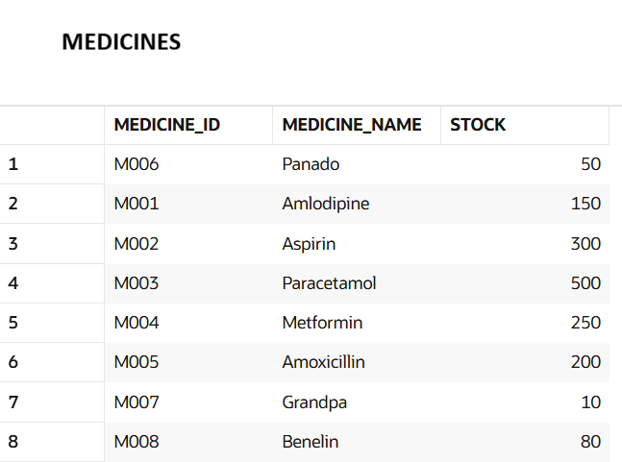
SQL (Query Results From Oracle LiveSql)
(screenshot)

Slide 94
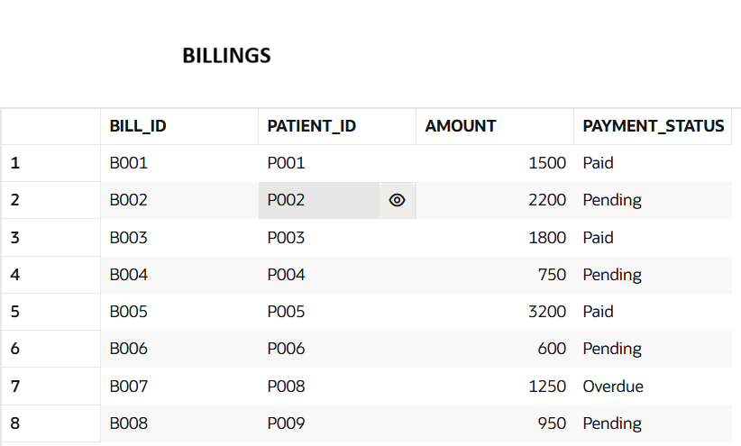
SQL (Query Results From Oracle LiveSql)
(screenshot)

Slide 95

SQL (Sample Outcomes)
(screenshot)
Total Number of Registered Patients
SQL
SELECT COUNT(*) AS total_patients
FROM PATIENTS;

Slide 96
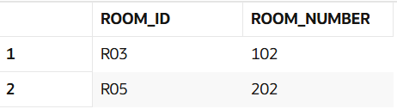
SQL (Sample Outcomes)
(screenshot)
Available Rooms
SQL
SELECT room_id, room_number
FROM ROOMS
WHERE room_availability = 'Available';

Slide 97
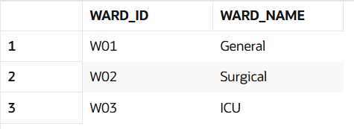
SQL (Sample Outcomes)
(screenshot)
Number of Admissions per Ward
SQL
SELECT w.ward_name,
COUNT(a.admission_id) total_admissions
FROM WARD w
JOIN ROOMS r ON w.ward_id = r.ward_id
JOIN ADMISSIONS a ON r.room_id = a.room_id
GROUP BY w.ward_name;

Slide 98
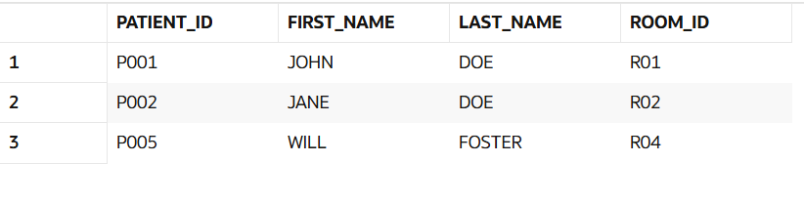
SQL (Sample Outcomes)
(screenshot)
Patients Currently Admitted
SQL
SELECT p.patient_id,
p.first_name,
p.last_name,
a.room_id
FROM PATIENTS p
JOIN ADMISSIONS a
ON p.patient_id = a.patient_id;

Slide 99
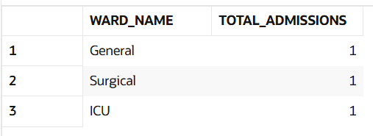
SQL (Sample Outcomes)
(screenshot)
Number of Admissions per Ward
SQL
SELECT w.ward_name,
COUNT(a.admission_id) total_admissions
FROM WARD w
JOIN ROOMS r ON w.ward_id = r.ward_id
JOIN ADMISSIONS a ON r.room_id = a.room_id
GROUP BY w.ward_name;

Slide 100
SQL (Sample Outcomes)
(screenshot)
Treatments Performed by Each Staff Member
SQL
SELECT s.staff_id,
s.initials,
COUNT(t.treatment_id) treatments_done
FROM STAFF s
LEFT JOIN TREATMENTS t
ON s.staff_id = t.staff_id
GROUP BY s.staff_id,s.initials;

Slide 101
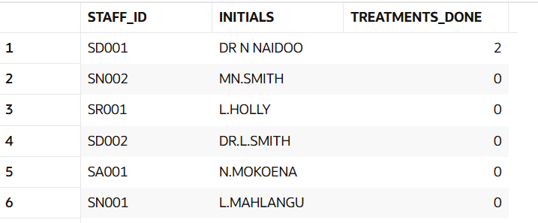
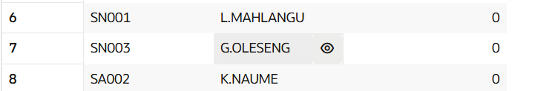
SQL (Sample Outcomes)
(screenshot)
Treatments Performed by Each Staff Member (outcome)

Slide 102
SQL (Sample Outcomes)
(screenshot)
Most Prescribed Medicine
SQL
SELECT m.medicine_name,
COUNT(*) times_prescribed
FROM MEDICINES m
JOIN PRESCRIPTIONS p
ON m.medicine_id = p.medicine_id
GROUP BY m.medicine_name
ORDER BY times_prescribed DESC;

Slide 103
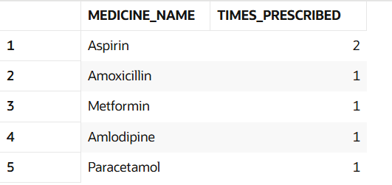
SQL (Sample Outcomes)
(screenshot)
Most Prescribed Medicine (outcome)

Slide 104
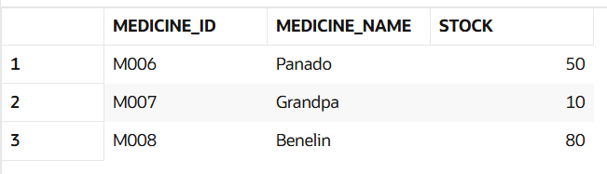
SQL (Sample Outcomes)
(screenshot)
Medicines with Low Stock(stock under 100)
SQL
SELECT medicine_id,
medicine_name,
stock
FROM MEDICINES
WHERE stock < 100;

Slide 105

SQL (Sample Outcomes)
(screenshot)
Total Revenue Generated
SQL
SELECT SUM(amount) AS total_revenue
FROM BILLING
WHERE payment_status = 'Paid';

Slide 106
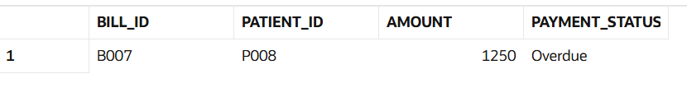
SQL (Sample Outcomes)
(screenshot)
Overdue Bills
SQL
SELECT *
FROM BILLING
WHERE payment_status = 'Overdue';

Slide 107
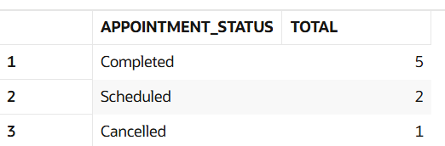
SQL (Sample Outcomes)
(screenshot)
Grouping appointments by status
SQL
SELECT appointment_status,
COUNT(*) total
FROM APPOINTMENTS
GROUP BY appointment_status;

Slide 108
Conclusion
The G14 Healthcare Facility Database Management System was successfully developed to show that a relational database can be used instead of an inefficient flat-file record keeping system to provide a structured, reliable and scalable solution. The project found some major problems with manual record keeping data duplication, slow data retrieval, lack of data organisation and data integrity problems. The solution to these problems was to normalize the database structure and implement it.
The database was designed in Third Normal Form (3NF), ensuring that it is free from data duplication and relationships between patients, appointments, admissions, wards, rooms, staff, treatments, medicines, prescriptions and bill records are well represented. The end result of this ERD was a clear model of these relationships, which was useful for both outpatient and inpatient healthcare processes.

Slide 109
Conclusion (cont)
The implementation phase showed that the database could store, managing and retrieving healthcare information through SQL queries. They got some sample results of queries, and the system has been able to provide them with meaningful reports like the number of patients registered, availability of rooms, admissions to the hospital, statistics of treatment, medicine stock details, billing details, and revenue details etc. The results demonstrate that the database is capable of efficient decision making and enhances access to information, which is better than the original manual system.
The crow's-foot ERD shows the final design for the database.
Overall, the suggested database solution will offer G14 Healthcare Facility a robust system for dealing with healthcare documents in a unified, secure, and efficient method. The system's ability to enhance data integrity, minimize data redundancy, and facilitate quick access to information and reporting aids in the smooth running of administrative processes and provides a foundation for future expansion to address evolving healthcare information management requirements.

